Slide 1
Introduction to Amazon Cloud
Amazon EC2 and Spot Overview
Patrick Guha
Solutions Architect
Amazon Web Services

Slide 2
Agenda
Introduction to Amazon Cloud
AWS Global Reach
Amazon EC2 Overview
Amazon EC2 Spot Overview

Slide 3

What is cloud computing?
Cloud computing is the on-demand delivery of IT resources and applications over the Internet with pay-as-you-go pricing.

Slide 4
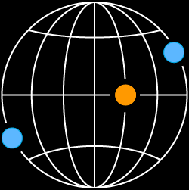
What is AWS?
AWS provides a highly reliable, scalable, low-cost infrastructure platform in the cloud that powers millions of businesses in over 245 countries and territories around the world.
Benefits
Low Cost
Elasticity & Agility
Open & Flexible
Secure
Global Reach

Slide 5

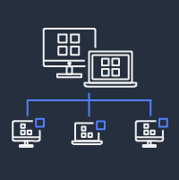




How AWS can help your research
Science, not servers
Use compute when you need
it to do large-scale analysis
Collaboration
Access data sets that span
institutions
Share effort
Leverage work done by
other scientists to save time
Reproduce research
A common platform for
reproducing scientific analyses
State-of-the-art analytics
Use data science methods
in your research
Security
A collection of tools to
protect data and privacy

Slide 6
AWS Global Reach

Slide 7


89 AWS Direct Connect locations
32
Regions

Slide 8


Availability Zones
Each AWS Region consists of multiple, isolated, and physically separate AZs within a geographic area
An Availability Zone (AZ) is one or more discrete data centers with redundant power, networking, and connectivity in an AWS Region
High throughput, low latency (< 10 ms) network between Availability Zones
All traffic between AZs is encrypted
Physical separation with 100 km (60 miles)
us-east-1 (N.Virginia)
Region
Availability Zone
Availability Zone
Availability Zone
us-east-1a
us-east-1b
us-east-1c

Slide 9
Amazon EC2 Overview

Slide 10
Amazon Elastic Compute Cloud (Amazon EC2)
Virtual server instances in the cloud
Linux | Windows | Mac
Arm and x86 architectures
General purpose and workload optimized
Bare metal, disk, networking capabilities
AMAZON EC2
Packaged | Custom | Community AMIs
Multiple purchase options: On-Demand, Spot instances, Reserved Instances, Savings Plans, Dedicated Hosts

Slide 11


Instance Types
General Purpose
Compute Optimized
Memory Optimized
Accelerated Computing
Storage Optimized
Burstable performance
General Purpose
Compute Intensive
Compute + network up to 100 Gbps*
Memory Optimized
In-memory
Memory Intensive
Compute and Memory Intensive
Graphics Intensive
General Purpose GPU
FPGA
High I/O
Dense Storage
Big Data Optimized
T3
M5
C5
C5n
R5
X1
X2iedn
G3
P2
F1
I3en
D3
H1
Local storage (NVMe SSD)
M5d
C5d
R5d
Z1d
I3
T3a
M5a
R6a
G5
metal
M5
C5
R5
u-24tb1
Z1d
I3
AWS Graviton
T4g
M7g
C7g
C7gn
R7g
X2gd
G5g
Im4gn

Slide 12
Instance Naming
Instance generation
c7gn.xlarge
Instance
family
Attribute(s)
Instance size

Slide 13
Instance Sizing
8xlarge
4xlarge
xlarge
2xlarge
xlarge
2xlarge
xlarge
xlarge
≈
≈
≈
4xlarge
2xlarge
xlarge
xlarge
2xlarge
xlarge
xlarge
c7gn.8xlarge
2 – c7gn.4xlarge
4 – c7gn.2xlarge
8 – c7gn.xlarge

Slide 14



Choose your processor and architecture
Intel® Xeon® Scalable (Skylake) processor
NVIDIA V100
Tensor Core GPUs
AMD EPYC processor
AWS Graviton Processor (arm)
FPGAs for custom
hardware acceleration
Right compute for the right application and workload

Slide 15
What’s a virtual CPU? (vCPU)
A vCPU is typically a hyper-threaded physical core*
Divide vCPU count by 2 to get core count
On Linux, “A” threads enumerated before “B” threads
On Windows, threads are interleaved
Cores by Amazon EC2 & RDS DB Instance type: https://aws.amazon.com/ec2/physicalcores/
* CPU Optimizing options allow disabling hyperthreading and reduce number of cores

Slide 16
Memory and Storage
What’s a GiB?
What about storage?
Storage is independent of compute
You allocate drives known as Amazon Elastic Block Store (EBS) volumes
Amazon EBS volumes support up to 64 TiB per volume
Some instance types provide physically attached (ephemeral) storage
Memory is presented as GibiBytes (GiB) and not Gigabytes (GB)
256 GiB = 275 GB

Slide 17
EC2 Operating Systems
Windows Server 2012/2012 R2/2016/2019/2022
Amazon Linux (NEW: Amazon Linux 2023)
Debian
SUSE
CentOS
Red Hat Enterprise Linux (RHEL)
Ubuntu
Mac, including M1 Mac instances
Visit the AWS Marketplace for more Operating Systems

Slide 18
What is an Amazon Machine Image (AMI)?
Provides the information required to launch an instance
Launch multiple instances from a single AMI with the same configuration
An AMI includes the following:
One or more Amazon Elastic Block Store (Amazon EBS) snapshots, or a template for the root volume (operating system, applications)
Launch permissions that control which AWS accounts can use the AMI
Block device mapping that specifies volumes to attach to the instance

Slide 19
Amazon EC2 purchase options
On-Demand
Pay for compute capacity by the second with no long-term commitments
Spiky workloads, to define needs
Reserved Instances
Make a 1 or 3 year commitment and receive a significant discount off On-Demand prices
Committed and steady-state usage
Savings Plans
Same great discounts as Amazon EC2 RIs with more flexibility
Committed flexible access to compute
Spot Instances
Spare Amazon EC2 capacity at savings of up to 90% off On-Demand prices
Fault-tolerant, flexible, stateless workloads

Slide 20
Simplifying capacity and cost optimization
SCALE USING SPOT FOR FLEXIBLE, FAULT-TOLERANT WORKLOADS
SCALE USING ON-DEMAND FOR NEW OR STATEFUL SPIKY WORKLOADS
USE RIs AND SAVINGS PLANS FOR KNOWN/ STEADY-STATE WORKLOADS

Slide 21
Amazon EC2 Spot Overview

Slide 22
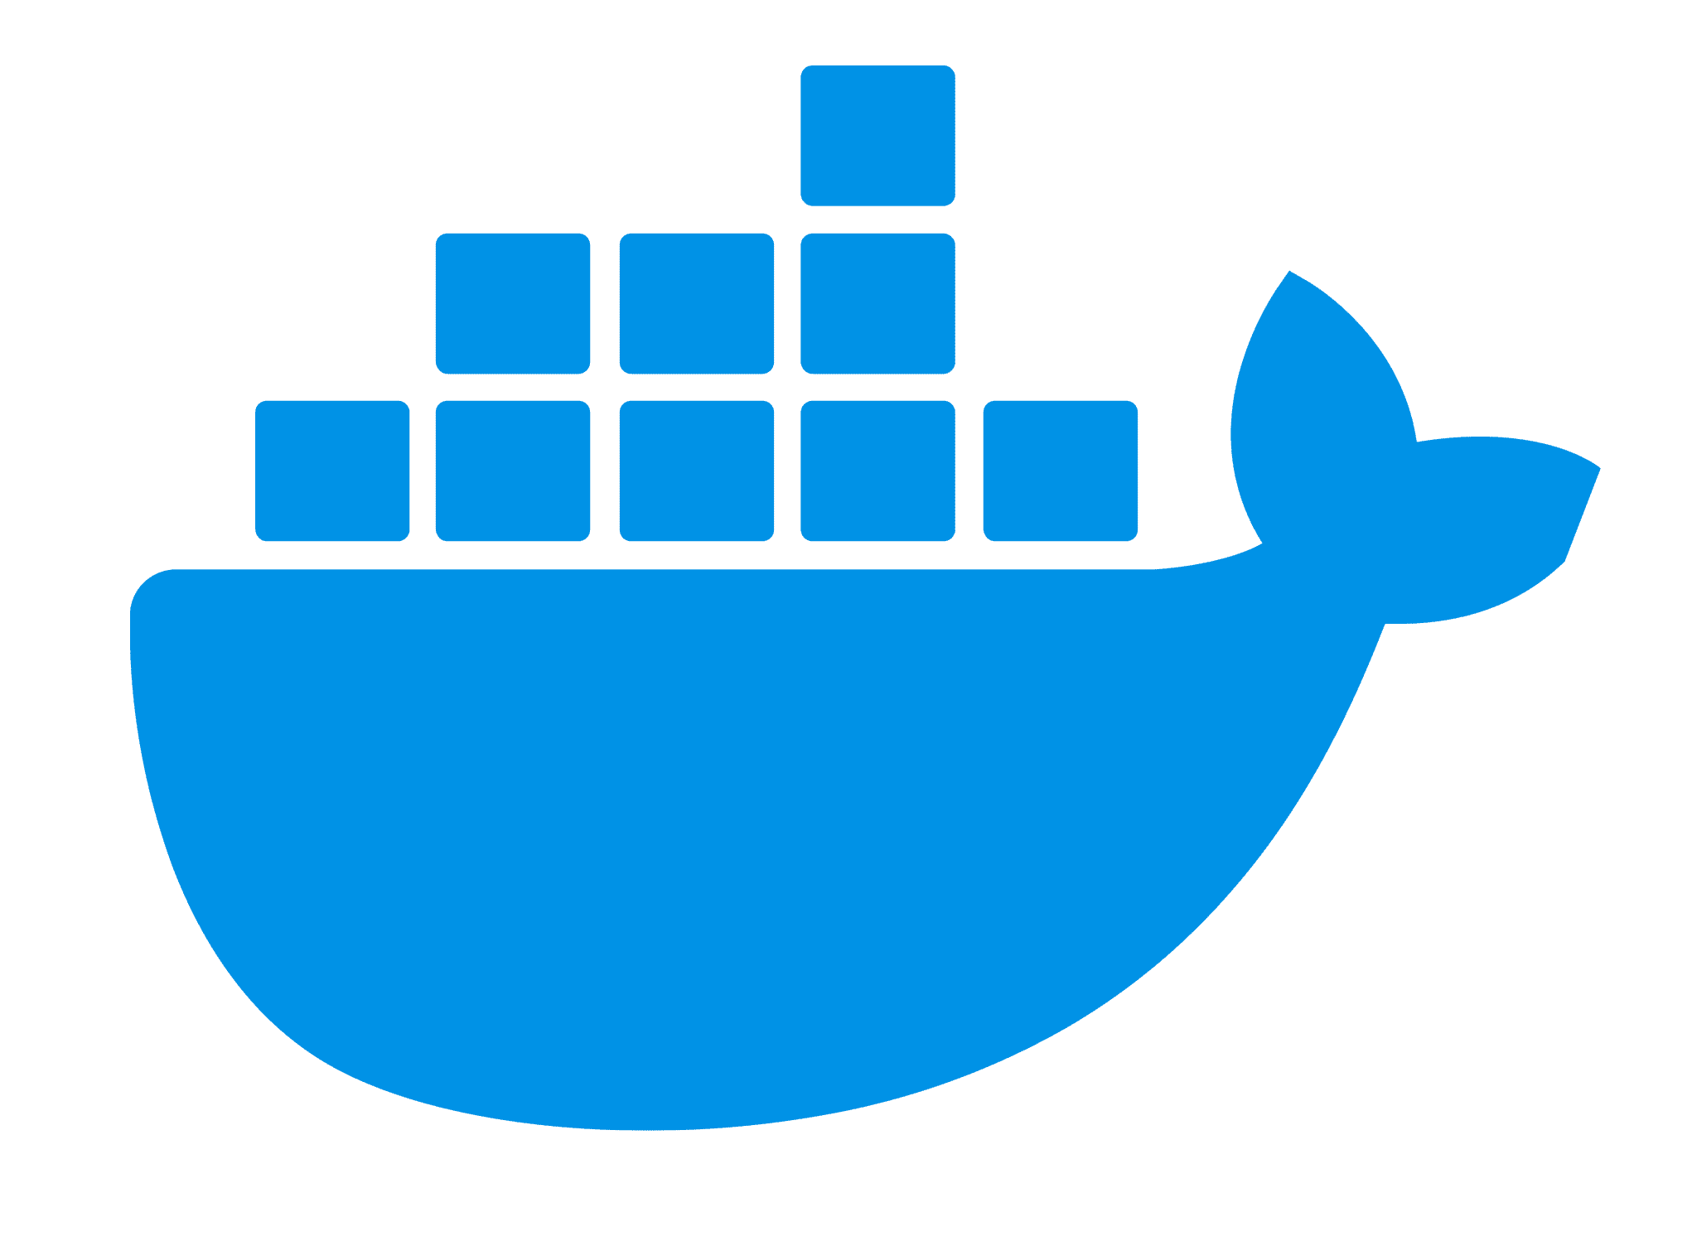
Amazon EC2 Spot
Spare Amazon EC2 capacity with savings of up to 90% over On Demand
Spot is ideal for workloads such as
Faster results
Increase throughput up to 10x while staying in budget
Big data
Simulations
AI/ML Training
HPC
Spot is ideal for:
Fault-tolerant
Flexible
Loosely coupled
Stateless workloads
Easy to use
Launch through AWS services or integrated third-parties
Or containerized
workloads

Slide 23


EC2 Spot Interruptions
By the nature of Spot as spare-capacity, instances can be reclaimed if needed by On-Demand
AWS provides 2-minute notifications to enable you to handle the response in an automated way
Diversification across instances reduces interruptions
Instance reclaim in 2 mins
c6i. 12xlarge
c6i. 12xlarge
c6i. 12xlarge
Historically, 95% of the Spot instances launched in the last 3 months completed without interruption
c6i. 12xlarge
c6i. 12xlarge
c6i. 12xlarge
c6i. 12xlarge
c6i. 12xlarge
c6i. 12xlarge
c6i. 12xlarge
c6i. 12xlarge
c6i. 12xlarge
c6i. 12xlarge
c6i. 12xlarge
c6i. 12xlarge
c6i. 12xlarge
c6i. 12xlarge
c6i. 12xlarge
c6i. 12xlarge
c6i. 12xlarge
c6i. 12xlarge
c6i. 12xlarge
c6i. 12xlarge
c6i. 12xlarge
c6i. 12xlarge
c6i. 12xlarge

Slide 24
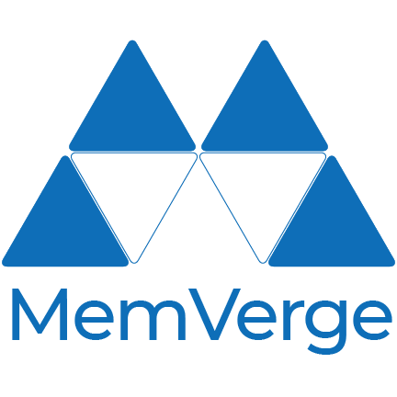
A better way to leverage Spot?
An up to 90% discount on EC2 is great, but you won’t see cost benefits if you have to re-run your job after Spot reclamations
Not all software comes with memory checkpointing built-in
3rd Party AWS Partners, like MemVerge, provide software to solve this problem

Slide 25
Patrick Guha
patrguha@amazon.com
www.linkedin.com/in/patrickguha

